Slide 1
Level Capstone: The Experiential Network
Zachary Boiskin
11/2/2018

Slide 2
The Experiential Network
Experience-based student-professional pairing program that allows students to take on real world business projects before graduation and for students to enhance student to professional relationships
Available for graduate and undergraduate students
Can be used as elective credit or specific class
Projects range from 6-8 weeks

Slide 3
Project Scope
At the end of every project, business sponsors are given survey to rate their experience with their assigned students
Using the provided survey data to gain insights to improve the Experiential Network Program at Northeastern University
What is the program doing well?
How can the program improve?
Recommendations and findings from the analysis for moving forward

Slide 4
Question Guide
Q1: Design thinking
Q2: Digital literacy
Q3: Critical thinking
Q4: Inclusive Action
Q5: Intercultural Competency
Q6: Verbal Communication
Q7: Conflict Resolution
Q8: Planning
Q9: Time management
Q10: Strategic thinking
Q11: Confidence
Q12: Self-directed learning
Q13: Leadership
Q14: Collaboration and Team work
Q15: Problem solving
Q16: Communication (general)

Slide 5
Data Cleaning
Cleared out unwanted/redundant rows, mostly headers
Check for and remove any duplicate entries
Updating any numerical types to desired type such as duration in seconds to duration in minutes with proper rounding ex. 5.5 minutes equals 5 minutes 30 seconds
Deleting unwanted columns that either provided no insights or for anonymity such as term of project season and IP address and names
Converting ‘overall thoughts’ section into only numeric
Isolating free responses into separate table to used uploaded separately
Uploading as final separate CSVs for Tableau import

Slide 6
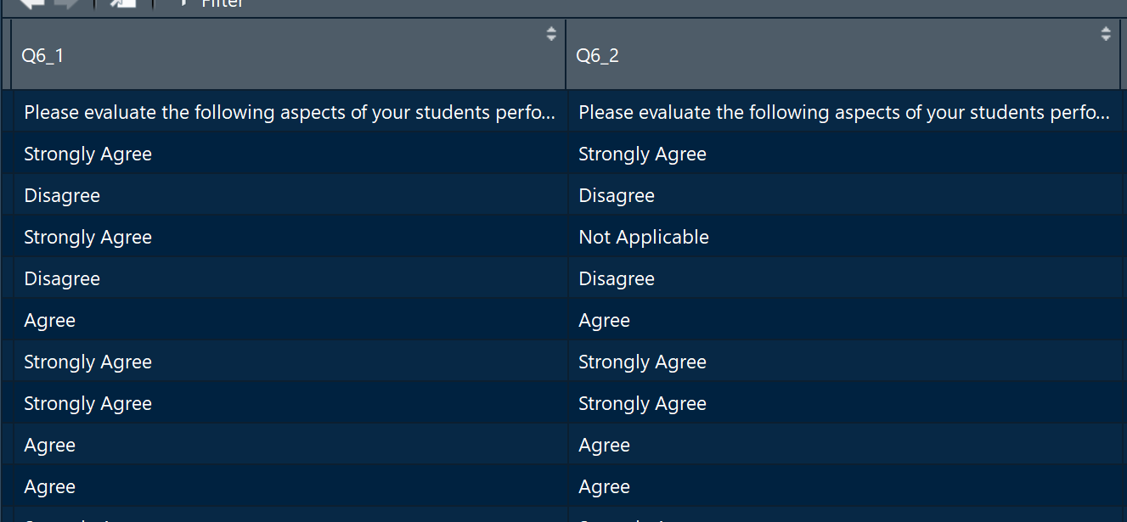
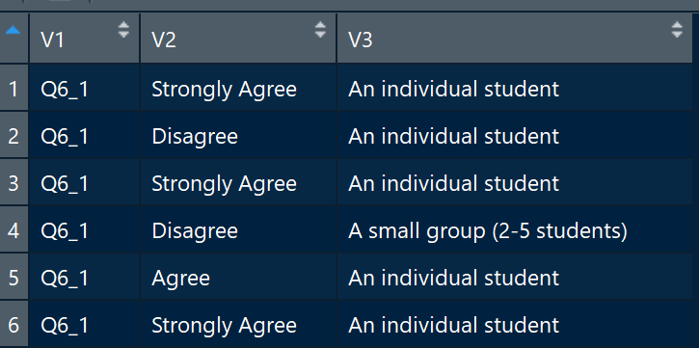
Data Formatting
Flipping the axis to have one column with all the question responses and one column with each response provided: Initially is was question by response per respondent.
Created function to run through each column in and paste the name in each row with it’s corresponding answer.

Slide 7
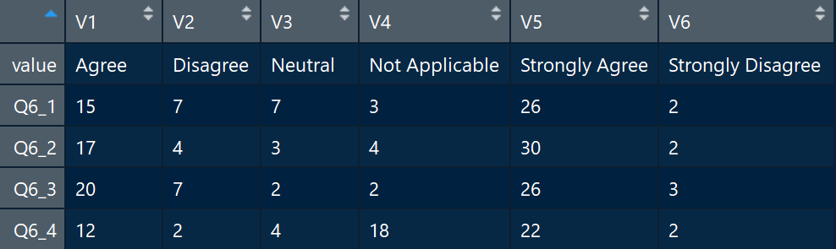
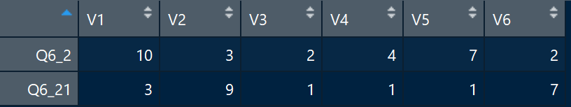
Data Formatting: Chi-Squared
Chi-squared: isolating individual sponsors by group sponsors
Reorder axis to have each column by response in order to provide a count: Using melt function to convert individual vs group responses
From there created another function to take each specific row and make it into a table to run test

Slide 8
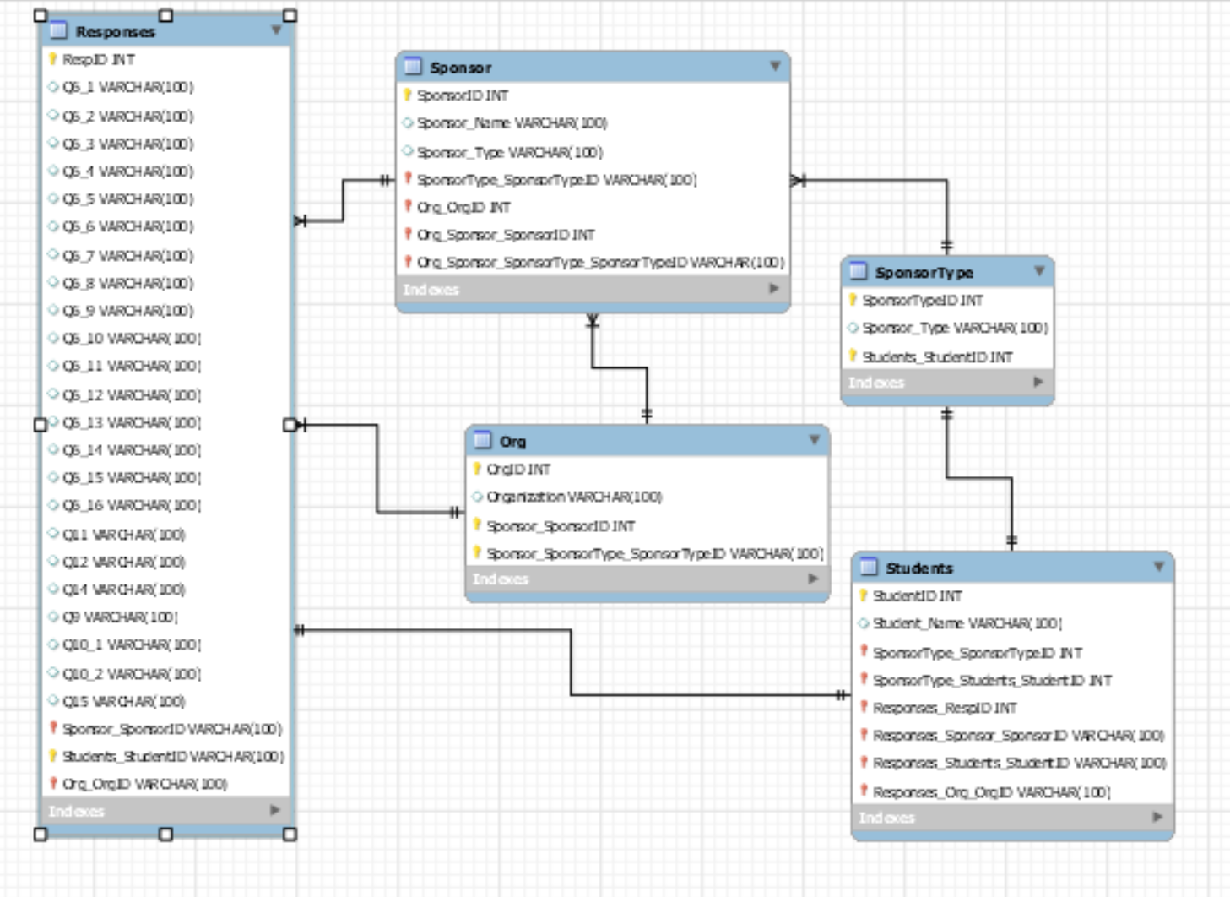
Schema

Slide 9
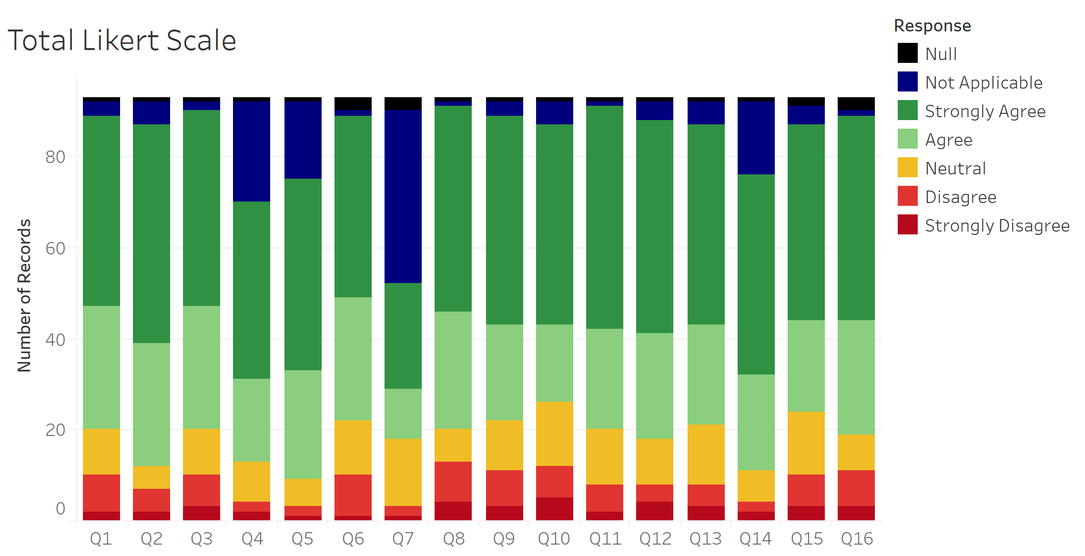
Aggregated Likert Scale Results:
Results are mostly positive with some more dependent on applicable like Q7. Deeper dive into frequency
Q1: Design thinking
Q2: Digital literacy
Q3: Critical thinking
Q4: Inclusive Action
Q5: Intercultural Competency
Q6: Verbal Communication
Q7: Conflict Resolution
Q8: Planning
Q9: Time management
Q10: Strategic thinking
Q11: Confidence
Q12: Self-directed learning
Q13: Leadership
Q14: Collaboration and Team work
Q15: Problem solving
Q16: Communication (general)

Slide 10
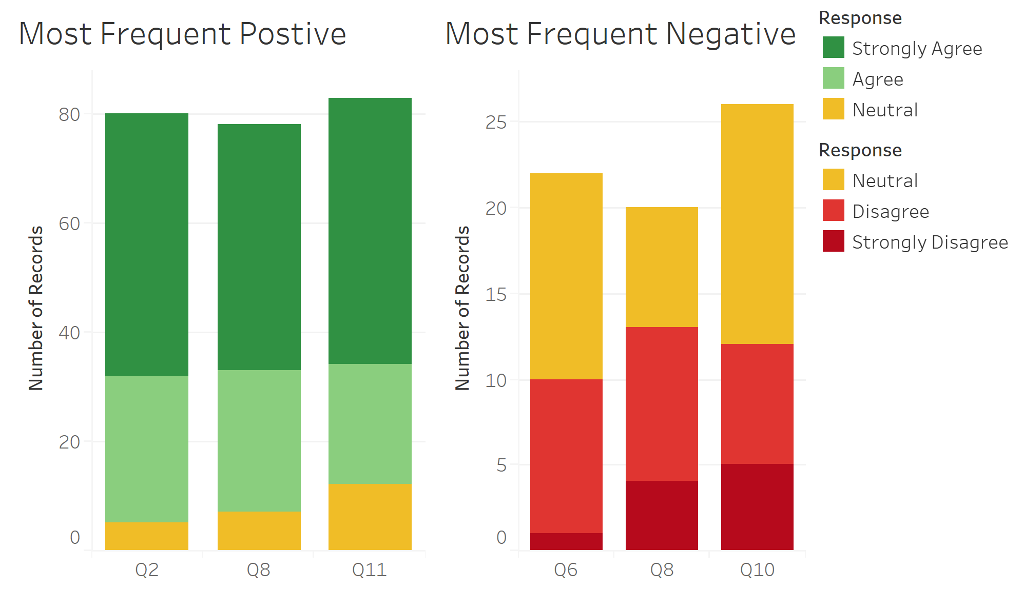
Total highest/lowest feedback scoring questions
‘Planning’ appears in both positive and negative indicating heavy polarization
Positive
Q2: Digital literacy
Q8: Planning
Q11: Confidence
Negative
Q6: Verbal Communication
Q8: Planning
Q10: Strategic Thinking

Slide 11
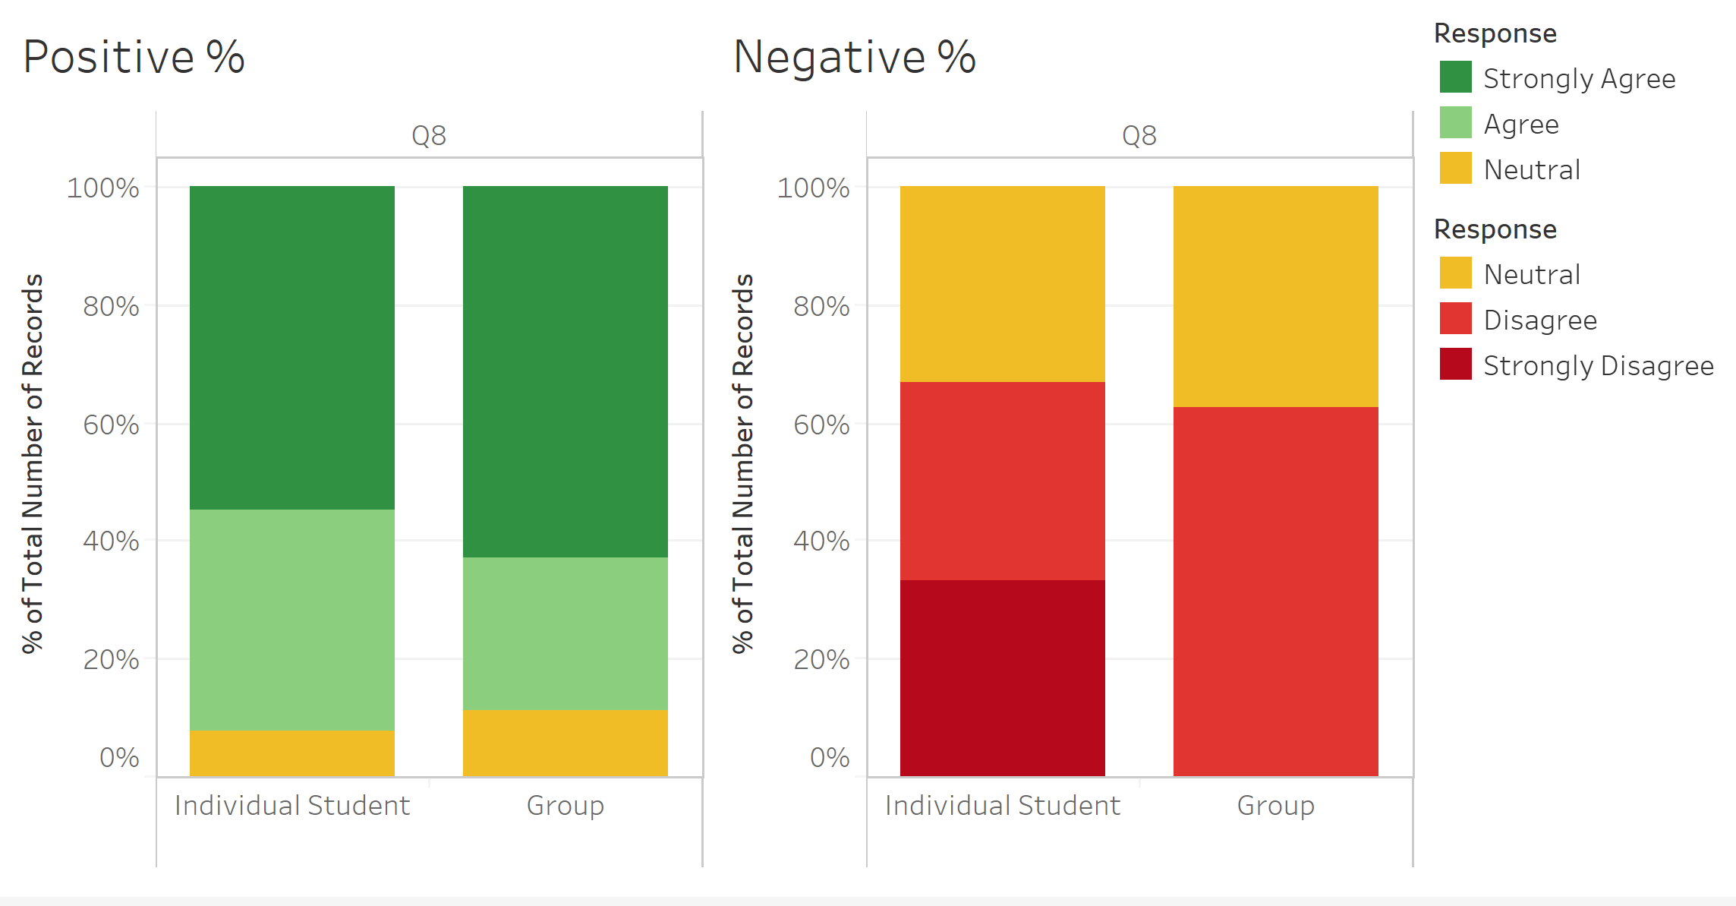
‘Planning’ % by individual vs group
Positive looks about the same. No ‘strongly disagree’ for group negative
Q8: Planning

Slide 12
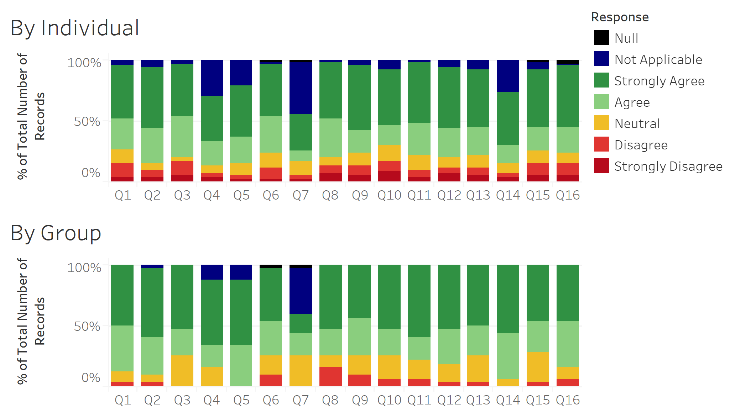
All Likert results by group
A lot less negative feedback for sponsors with group projects
Q1: Design thinking
Q2: Digital literacy
Q3: Critical thinking
Q4: Inclusive Action
Q5: Intercultural Competency
Q6: Verbal Communication
Q7: Conflict Resolution
Q8: Planning
Q9: Time management
Q10: Strategic thinking
Q11: Confidence
Q12: Self-directed learning
Q13: Leadership
Q14: Collaboration and Team work
Q15: Problem solving
Q16: Communication (general)

Slide 13
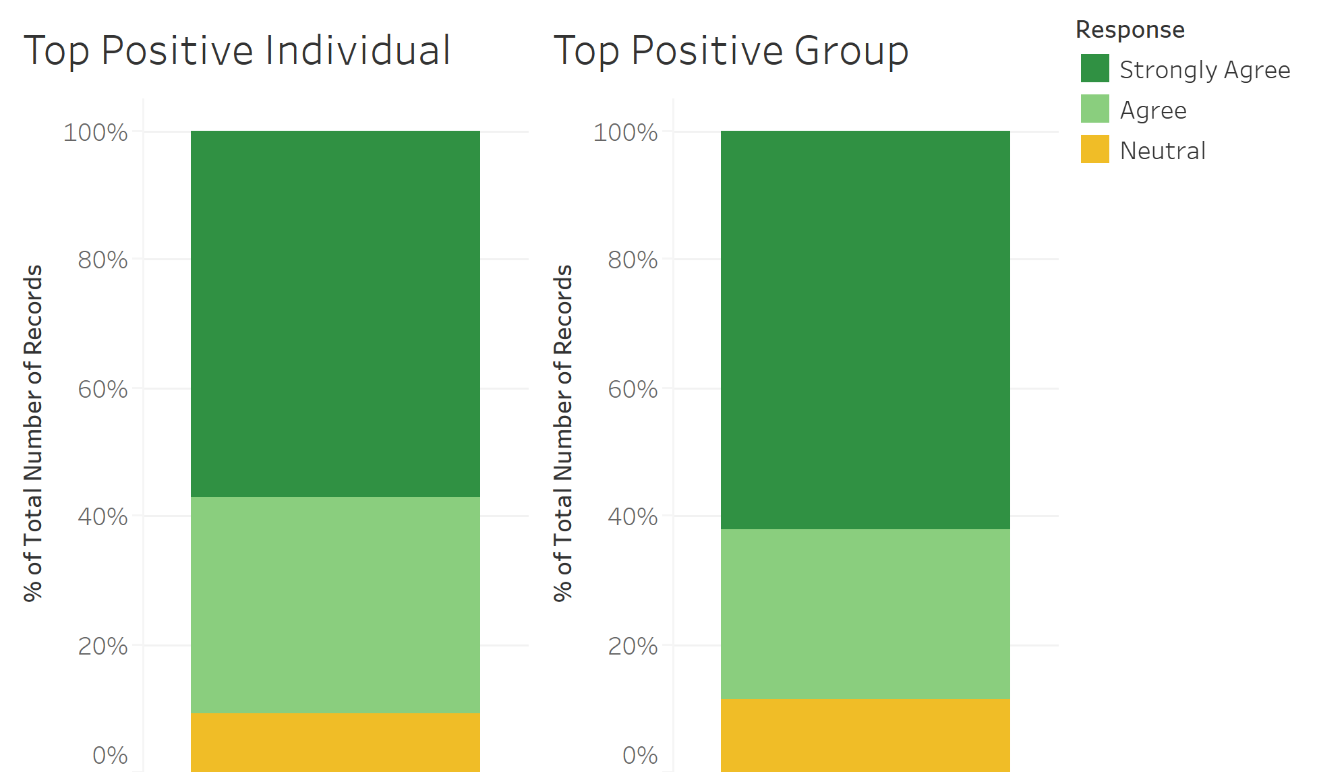
Top positive question split by group
Can see that the aggregate shown here matches the individual question 8
Positive
Q2: Digital literacy
Q8: Planning
Q11: Confidence

Slide 14
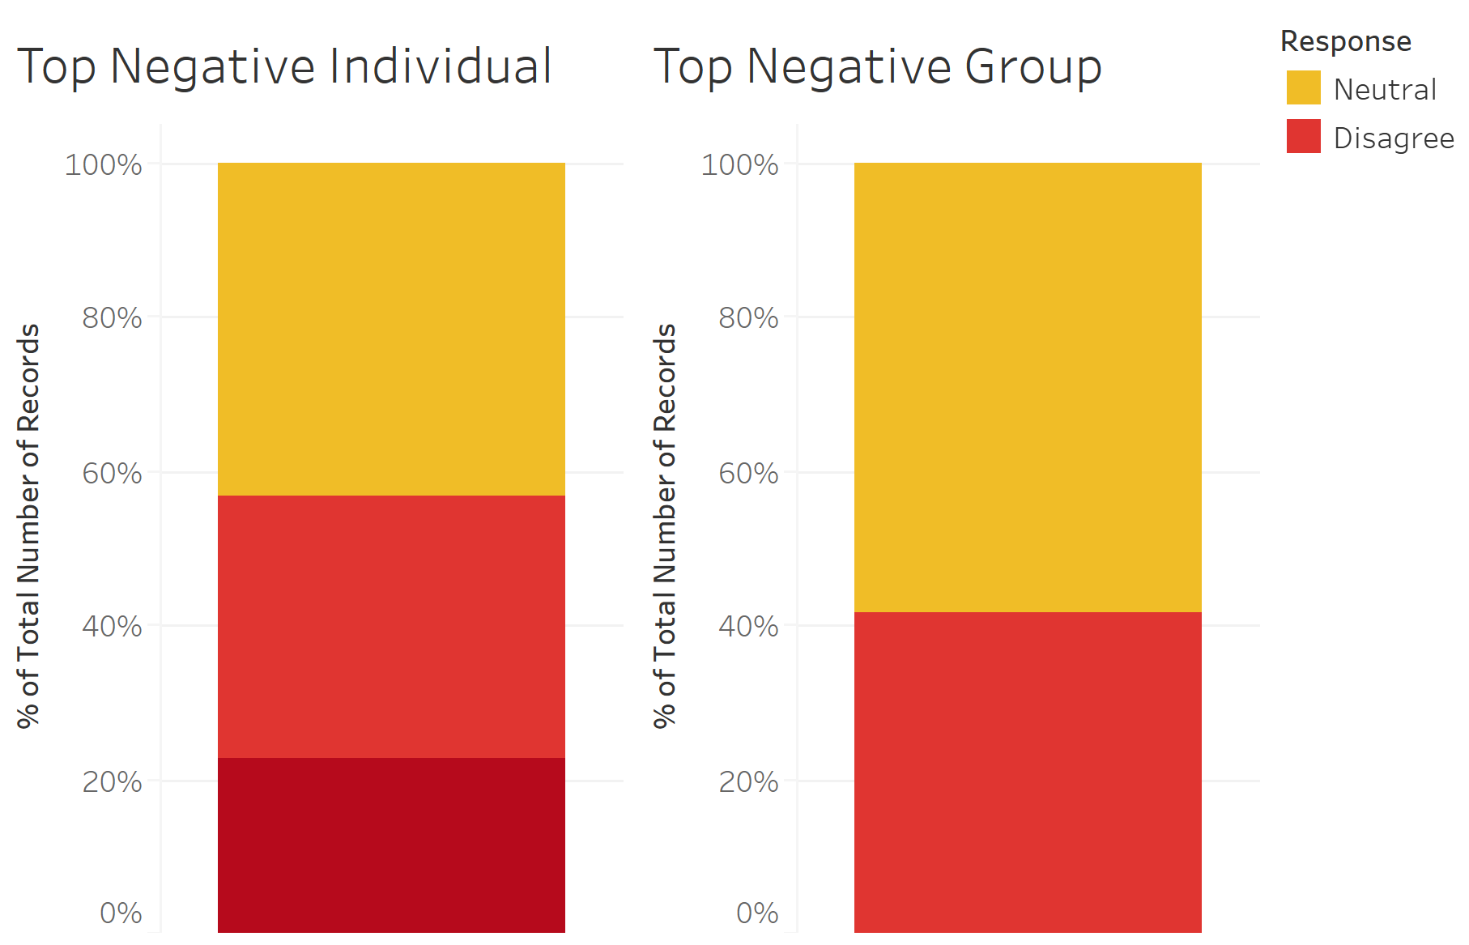
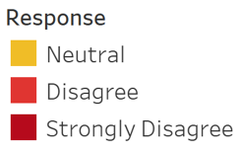
Top negative questions split by group
Can see that the aggregate shown here matches the individual question 8
Negative
Q6: Verbal Communication
Q8: Planning
Q10: Strategic Thinking

Slide 15
Chi Squared Test for Independence Hypothesis
Ho: There is no association between the Likert scale options chosen and whether the sponsor had an individual student or a group of students for the XN project. I.E. answer choice chosen is independent of group size
Ha: there is some association between the Likert scale answer chosen and the sponsor group size. I.E. the answer choice chosen is dependent on the size of the group
If p < .05 we reject the Ho and can infer that the answer choice chosen and group size are NOT independent (or are dependent) of each other and there is some association

Slide 16
Chi Squared Test Results
Questions with statistical significance that did show evidence of being dependent p <.05
Independent
Q4: Inclusive Action
Q5: Intercultural Competency
Q7: Conflict Resolution
Q8: Planning
Q9: Time management
Q10: Strategic thinking
Q11: Confidence
Q12: Self-directed learning
Q13: Leadership
Q15: Problem solving
Q16: Communication (general)
Q1: Design Thinking: p value of .03
Q2: Digital Literacy: p value of .007799
Q3: Critical Thinking: p value of .023
Q6: Verbal Communication: p value of .0003
Q10: Strategic Thinking: p value of .04
Q14: Collaborative and Team Work: p value of .04

Slide 17
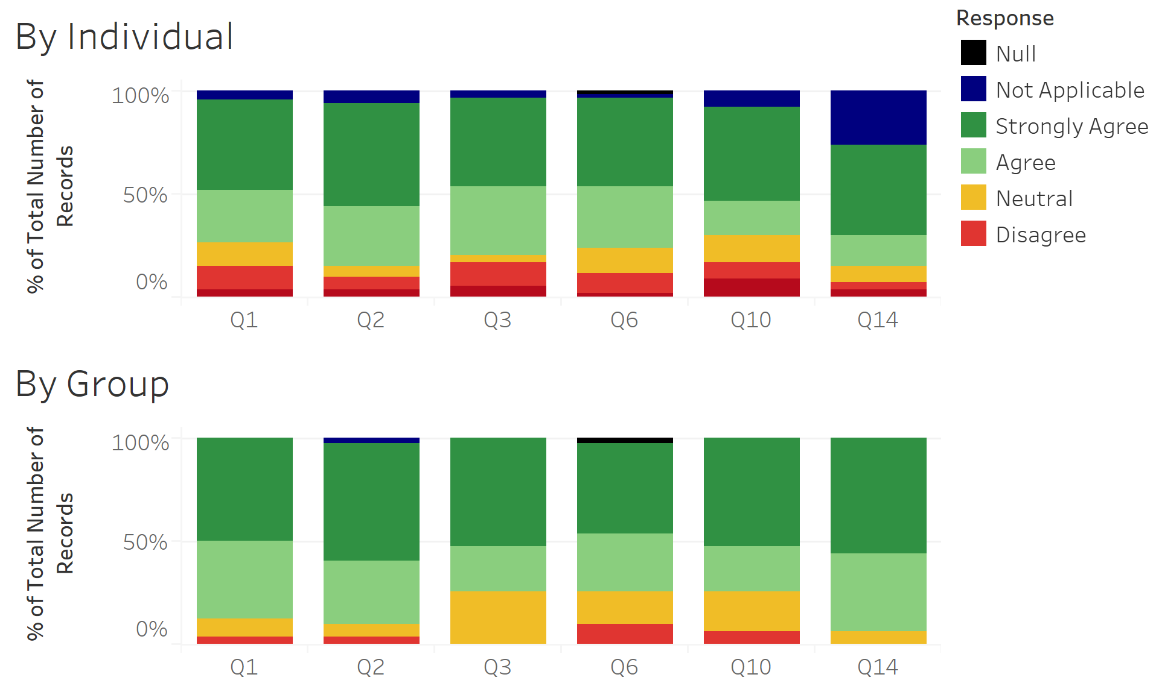
Chi Squared Test Results
Questions with statistical significance that did show evidence of being dependent p <.05
Q1: Design Thinking
Q2: Digital Literacy
Q3: Critical Thinking
Q6: Verbal Communication
Q10: Strategic Thinking
Q14: Collaborative and Team Work

Slide 18
Likert Scale Summary and Recommendations
Group projects seem to yield more positive results than individual projects
If a certain aspect is positive overall, it seems to maintain that status between individual vs group
But Group projects have much fewer problems quantified by the lack of strongly disagree/disagree Likert answers chosen

Slide 19
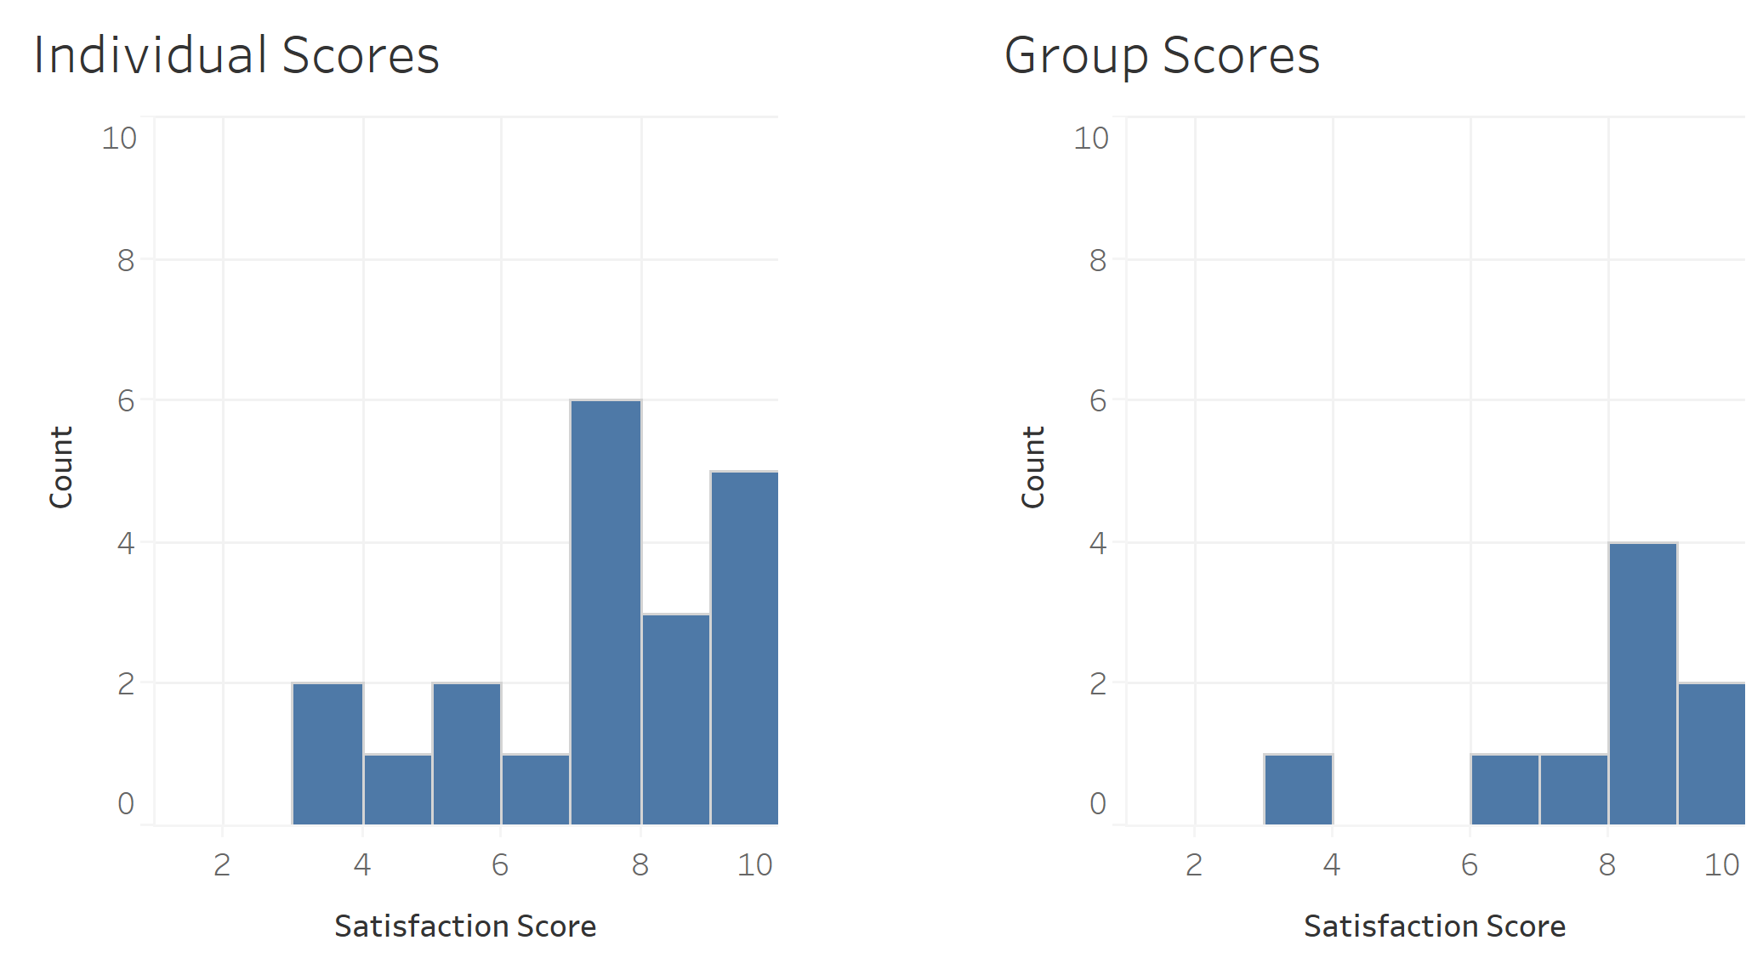
Overall, how satisfied were you with your experience?
Avg 6.9
Avg 7.3
20 responses
9 responses

Slide 20
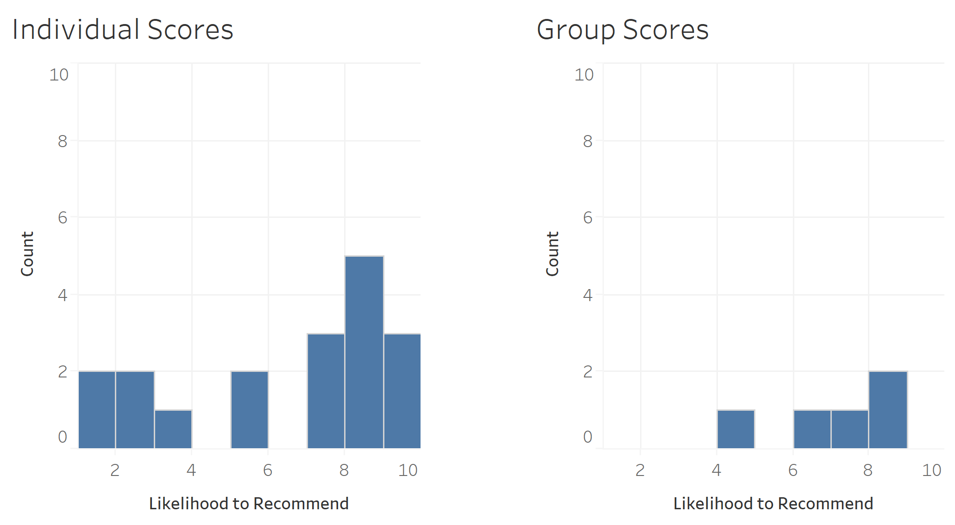
How likely would you be to recommend the Experiential Network to a friend or colleague?
Avg 5.9
Avg 6.9
18 responses
5 responses

Slide 21

Word Cloud: Positive

Slide 22

Word Cloud: Suggestions

Slide 23
Recommendations
Move Q10: overall approval and recommendation question towards the beginning
Make results numerical from scale
Provide a more concise scope of the project for clear expectations
Technology tools assessment
Set University check-in and progress deadlines
Help foreign students with language barrier and clarify typical professional communication practices
Assign University liaison to act between student and sponsor

